Slide 1
Vaccine discovery:
Jenner and smallpox
Danica Milovanović
LVG, Didier Trono’s lab

Slide 2
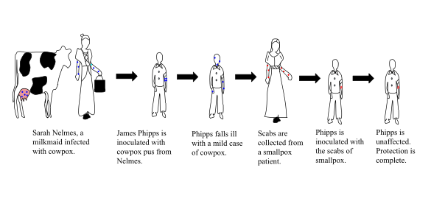
Vaccine
def. a biological product that can be used to safely induce an immune response that confers protection against infection and/or disease
Prior: variolation* / inoculation: practiced in India, China, Ottoman Empire
18th century England: Lady Mary Wortley Montague; Edward Jenner: influence of folklore and 1798 paper:
An Inquiry into the Causes and Effects of the Variolae Vaccinae, a disease discovered in some of the western counties of England, particularly Gloucestershire and Known by the Name of Cow Pox
* Variola: Bishop Marius of Avenches: 570 AD Lausanne, CH
Vaccination Act 1840
1892: discovery of viruses
1980: WHO declares naturally occurring smallpox eradication
CDC Atlanta, USA; Vector, Novosibirsk, Russian Federation
https://www.britannica.com/science/vaccine
Riedel S. (2017) Baylor University Medical Center Proceedings
https://www.who.int/
Flemming A. (2020) Nature Portfolio

Slide 3
debate:
Is the research with live variola virus necessary from the public health perspective?
Would you destroy the last remaining stocks of live variola virus?

Slide 4
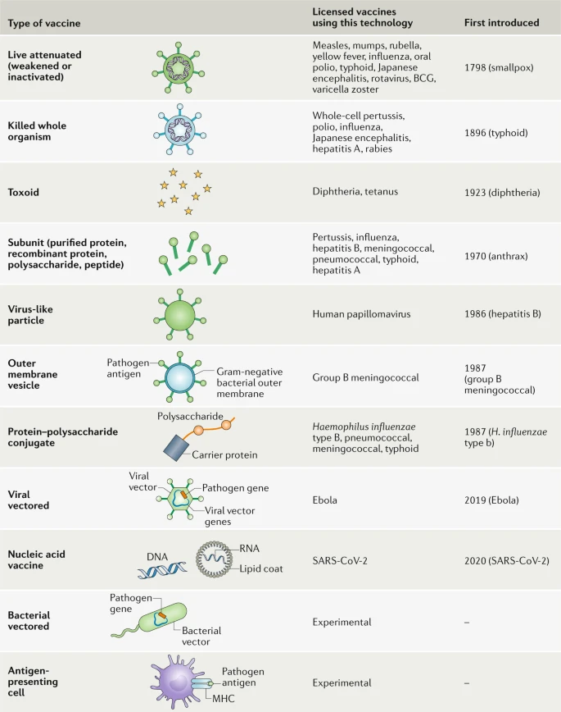
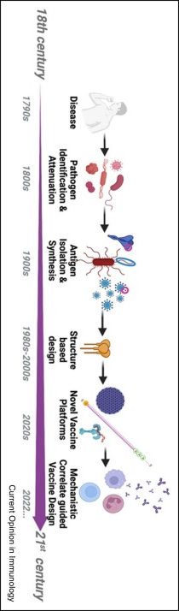
Vaccine design
Features of vaccine-induced protection:
Memory
Herd immunity
Prevention of infection/disease
New era? Phages?
Pollard AJ., Bijker EM. (2021) Nature Reviews Immunology
Britto C. Alter G. (2022) Current Opinion in Immunology

Slide 5
Quiz
Is it safe for babies to get multiple vaccines?
2. What do you think is the vaccine which doesn’t induce herd immunity?
A. smallpox
B. pertussis
C. tetanus
3. Immuno-compromised individuals can receive passive vaccination?
4. MMR vaccine causes autism?
Yes, contrary to the myth of antigenic overload
Tetanus, not contagious
Yes, active vaccination could lead to severe unwanted side effects.
NO! importance of scientific transparency and literacy

Slide 6
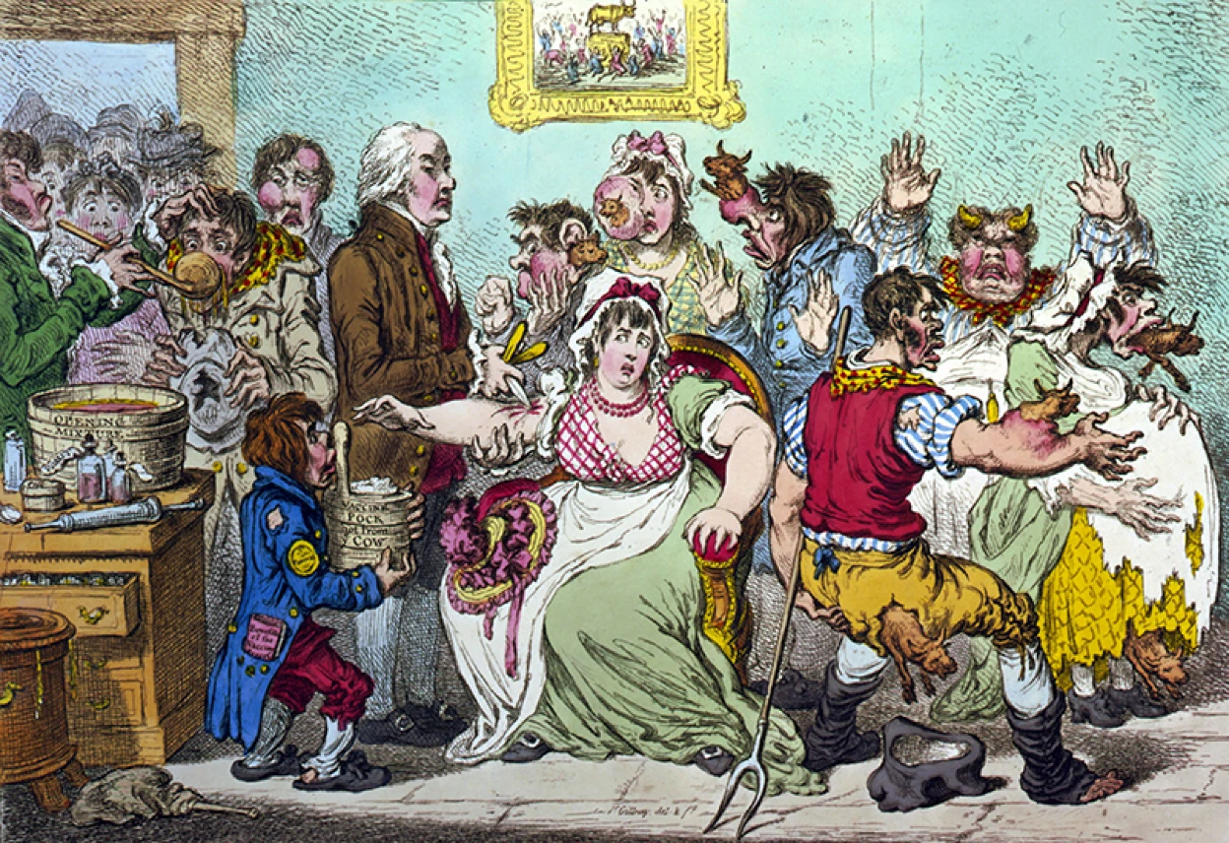
Public trust in vaccines
trust in science – namely the ability of biomedical research to produce a safe and effective vaccine – had the most impact on the decision to get vaccinated
Vaccine hesitancy:
Contextual influence
Individual/group influences
Vaccine-specific influence

